Slide 1
How to use the Golgi Convex Hull program
Seoyoung Park

Slide 2
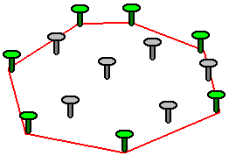
Golgi Convex Hull program
Creates convex hull (smallest convex set that contains a given set of points or a shape) in selected ROI of the Golgi complex
To quantify how dispersed the Golgi is
Also, automatically sets scale by detecting the scale bar
Programmed in python
Concept of a convex hull

Slide 3
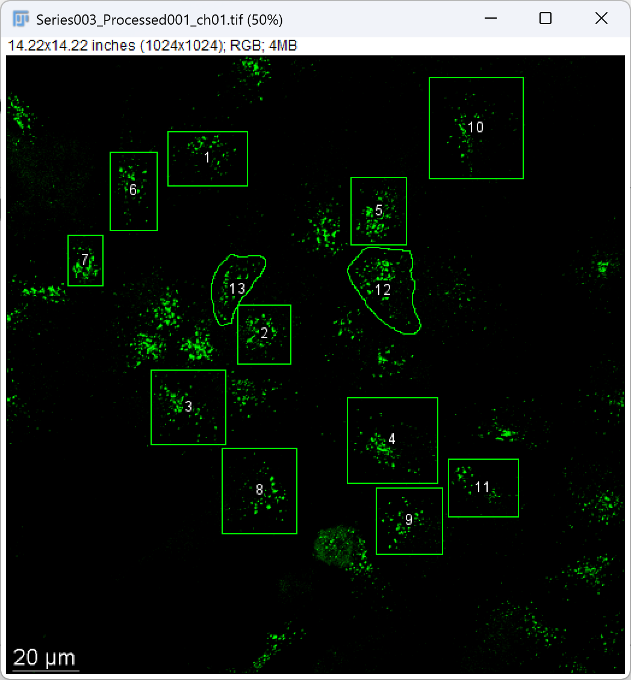
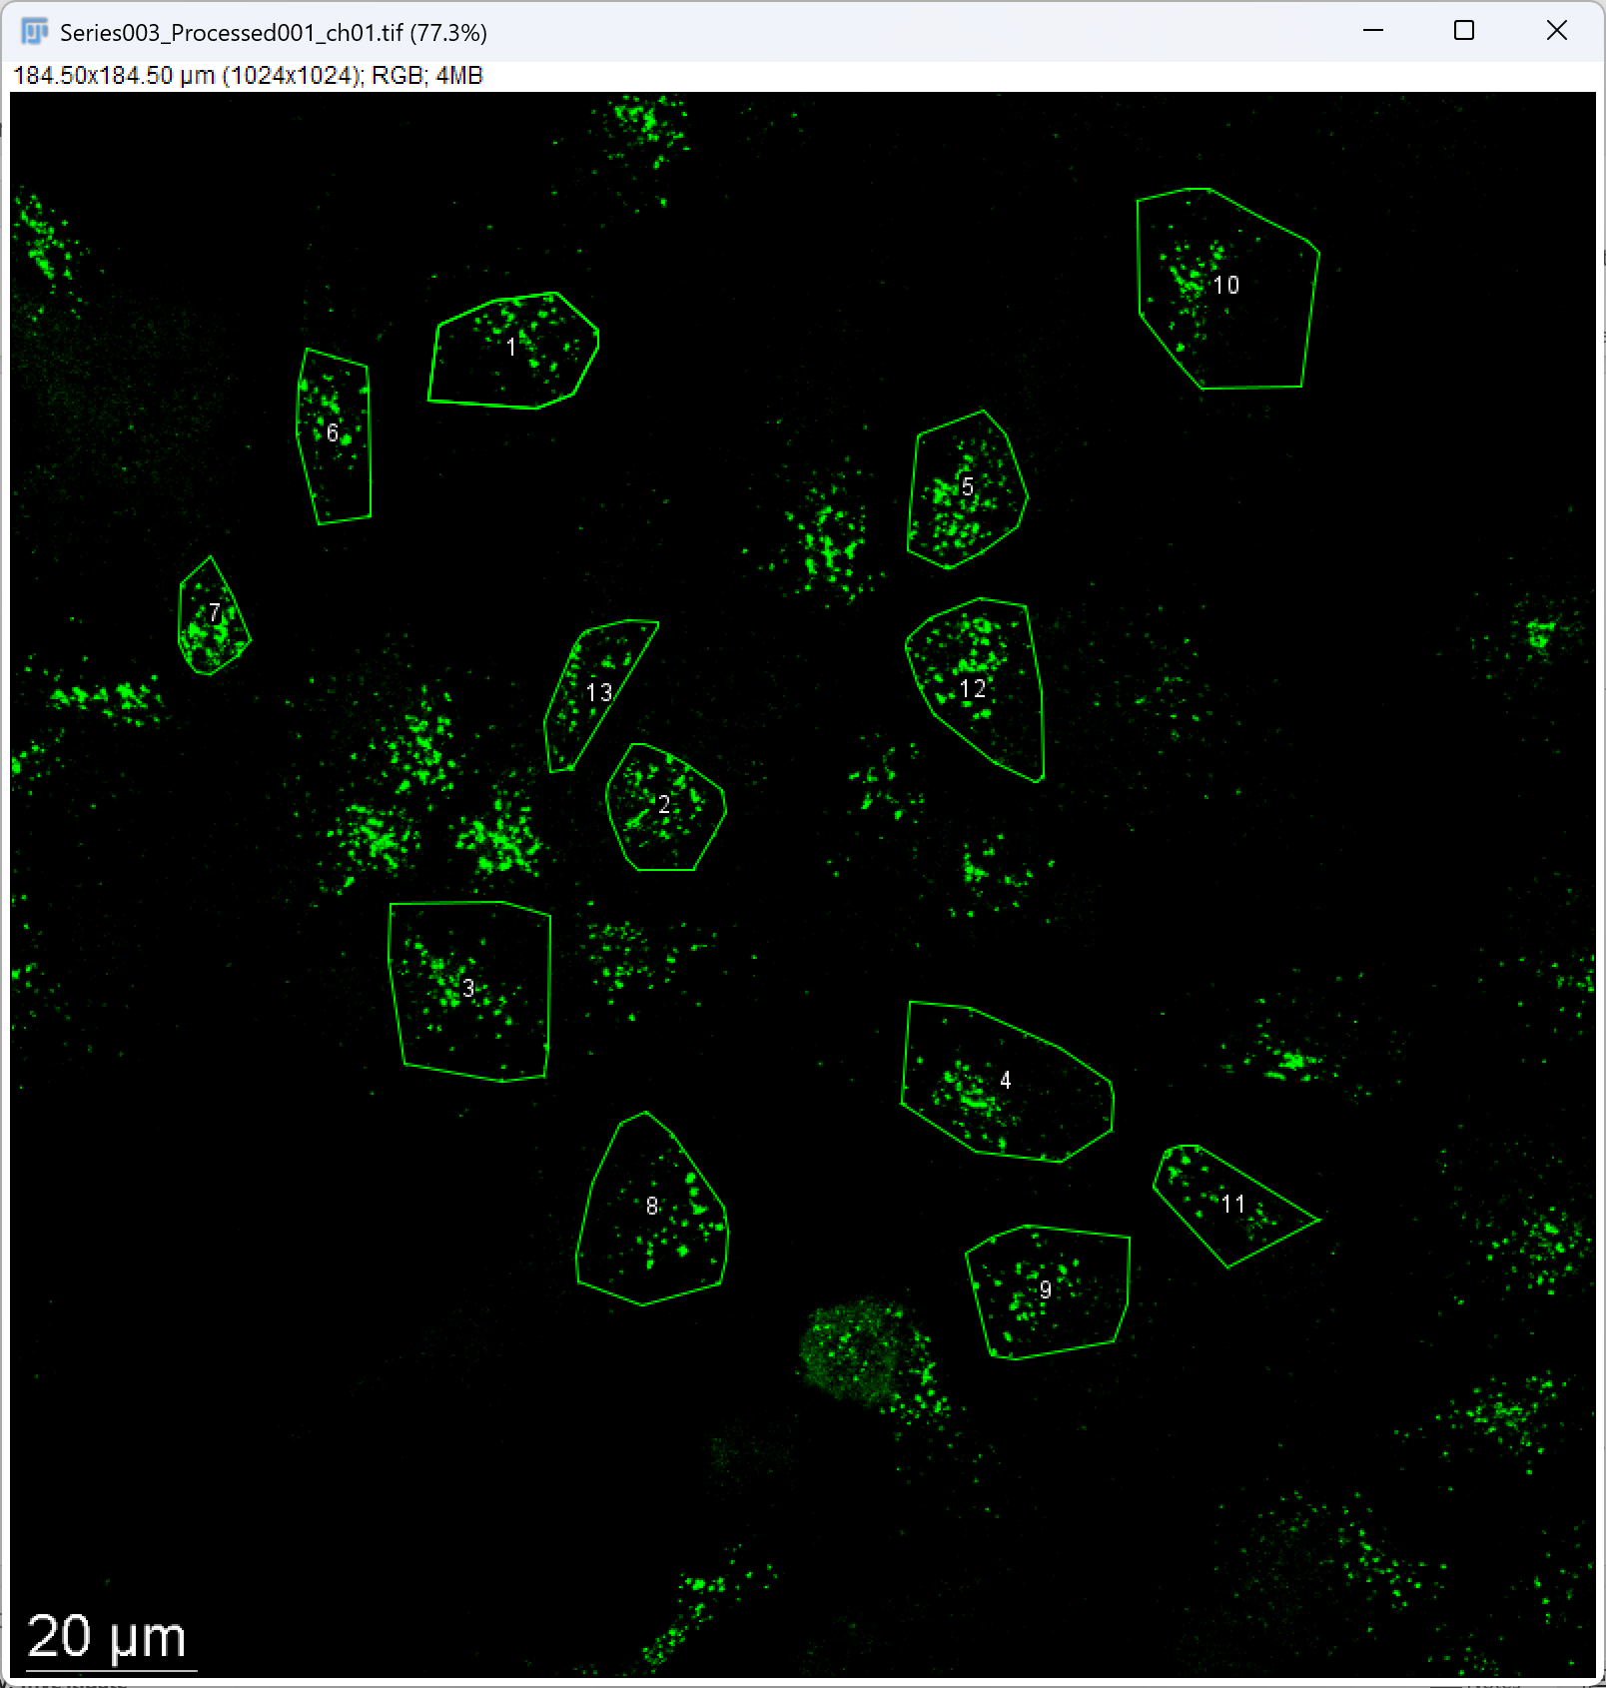
Example of program results

Slide 4
Options
Run the .exe file (might be slower)
Install packages/python manually and run program

Slide 5
Prerequisitions
ROI area of Golgi needs to be selected (the edges doesn’t have to be precise, only to include the whole Golgi)
ROI sets should be saved as a .zip file

Slide 6
How to run the .exe file
Extract the .zip file “Golgi_convexhull.exe.zip”
Under folder “dist”, there is “golgi_convexhull.exe”
Select and run the golgi_convexhull.exe file (might take long initializing)
Select image file to analyze
Select ROI sets of the image
Select the folder to save results
Enter the length of the scale bar in micrometers (µm)

Slide 7
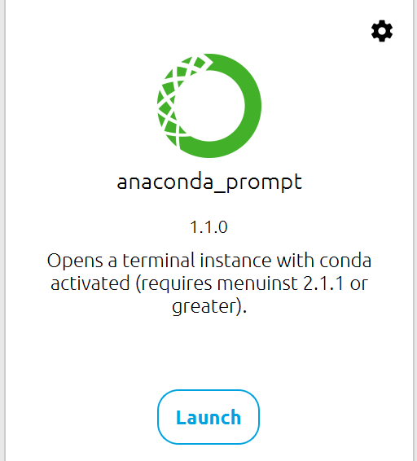
How to run through Python environment
Install Anaconda (https://www.anaconda.com/download)
Open anaconda prompt after installing Anaconda
Type the following:
cd [Insert the folder location]
pip install -r requirements.txt
python golgi_convexhull.py
Check if requirements.txt and golgi_convexhull.py is in the same folder

Slide 8
How to run through Python environment
Run .ipynb file in Jupyter notebook
Or run .py file in any IDE
Select image file to analyze
Select ROI sets of the image
Select the folder to save results
Enter the length of the scale bar in micrometers (µm)

